Slide 1
CarlosFloresDA Project #1
Employee Attrition Analysis – HR
Excel + PivotTables + Dashboard
By: Carlos Flores

Slide 2
Project Objective
Goal:
To identify the factors that explain employee attrition and build an interactive dashboard in Excel that allows analysis of:
Who is resigning?
Why are they resigning?
Which variables most influence attrition?
What patterns are observed in revenue, WLB, overtime, roles, etc.?
Outcome:
Professional dashboard + actionable insights for HR.

Slide 3
Business Problem
The company experiences a significant level of employee turnover.
This results in:
- Replacement costs
- Loss of talent
- Impact on productivity
- Operational risks
Need:
Identify the main drivers of attrition to make informed decisions

Slide 4
Dataset Used
Dataset used: Adapted version of the IBM HR Analytics Employee Attrition Dataset.
Number of records:≈ 1,470 employees
Main columns included:
Note:
This dataset was reorganized to facilitate analysis, but maintains the structure and purpose of the original dataset.
Demographics Age Gender Marital Status CF_age band Employment data Department Job Role Job Level Monthly Income Monthly Rate Daily Rate Hourly Rate OverTime Business Travel Total Working Years Years At Company Years In Current Role Years Since Last Promotion Years With Current Manager | Satisfaction (scales 1–4) Job Satisfaction Work-Life Balance Relationship Satisfaction Environment Satisfaction Job Involvement Variables created (CF_) CF_attrition label (Current vs Ex-Employees) CF_attrition count (1/0) CF_attrition rate CF_current employee CF_age band Target Variable Attrition (Yes/No)

Slide 5
Data Preparation
Actions performed in Excel:
Column cleaning
Data type validation
Conversion of Attrition to 1/0 variables
Creation of CF_ metrics
Grouping of Monthly Income
Review of 1–4 scales
Normalization of categories (Travel, Education Field, etc.).

Slide 6
KPI Definitions (Upper Zone of the Dashboard)
Main KPIs calculated:
Ruler:
Only Attrition Rate is a percentage.
General Condition Total Employees Active Employees Attrition Count Attrition Rate (%) Basic Demographics Average Age Average Distance From Home Finances Average Monthly Income | Work Experience Average Tenure Average Total Working Years Satisfaction Average Job Satisfaction Average Work-Life Balance Average Relationship Satisfaction Growth and Carrer Average Years Since Last Promotion Average Years With Current Manager

Slide 7
PivotCHarts Used (Central Zone of the Dashboard)
In the central zone, we placed the four main charts, which best explain attrition behavior at a structural level.
Charts included in the Central Zone:
1. Attrition by Job Role
Shows which roles have the highest turnover.
Identifies critical areas such as Sales and Laboratory Technician.
2. Attrition by Department
Compares turnover between Sales, R&D, and HR.
Allows you to see which departments require intervention.
3. Attrition by Education Level
Analyzes whether educational level influences resignation.
Useful for understanding risk profiles.
4. Attrition by Age Band
Shows which age groups resign most frequently.
Generally, young adults (25–34) have higher attrition rates.
These four charts form the core of the dashboard's structural analysis.

Slide 8
PivotCHarts Used (Lower Zone of the Dashboard)
In the lower area we placed the graphics that explain the drivers of attrition, that is, the strongest causes.
Charts included in the Lower Zone:
5. Attrition by Overtime
- Compares turnover between employees with and without overtime.
- Reveals the impact of burnout.
6. Attrition by Distance From Home
- Shows if distance influences turnover.
- Useful for understanding job mobility.
7. Attrition by Work-Life Balance
- Key chart: Low WLB = higher turnover.
- One of the strongest drivers.
8. Attrition by Monthly Income
- Shows how income affects turnover.
- Lower income brackets have higher attrition.
These four charts explain the "why" of attrition.

Slide 9
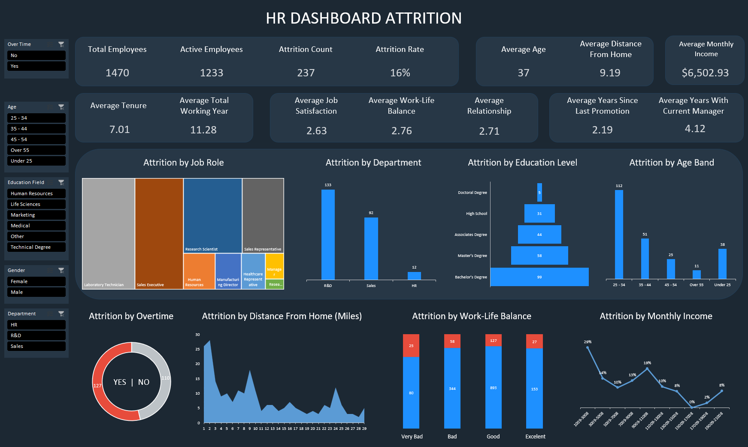
Dashboard Layout

Slide 10
Key Insights (Central Zone)
Attrition by Job Role
• Roles such as Sales Executive and Laboratory Technician have the highest turnover.
• Administrative and management roles show lower attrition.
2. Attrition by Department
• R&D has the highest turnover rate.
• Sales maintains moderate levels.
• HR has the lowest turnover.
3. Attrition by Education Level
• Employees with a High School Diploma and Associate Degrees are more likely to quit.
• Higher education levels show lower attrition.
4. Attrition by Age Band
• The 25–34 age group is the most likely to quit.
• Employees over 55 have lower turnover.

Slide 11
Key Insights (Lower Zone)
5. Attrition by Overtime
- Employees who work overtime are slightly more likely to quit.
- This indicates that work overload or burnout can intensify the decision to resign.
6. Attrition by Distance From Home
- Employees who live closer to work tend to quit more frequently.
7. Attrition by Work-Life Balance
- Level 1 (very bad) has the highest quit rate.
- As work-life balance improves, turnover decreases, but the effect is not as pronounced.
8. Attrition by Monthly Income
- Lower salary ranges have the highest turnover.
- Above a $11009 income , quit rates decrease.

Slide 12
Summary of Findings
- The overall attrition rate is 16%.
- Turnover is concentrated among younger employees (25–34).
- Sales and technical roles experience higher attrition.
- Employees with lower incomes resign more frequently.
- Overtime and work-life balance are critical drivers.

Slide 13
Conclusions
Conclusion 1 — Critical Factors
Attrition is strongly influenced by:
- Monthly Income
- Job Role
- Age Band
- Education Level
Conclusion 2 — Risks Identified
Young employees, those with low incomes, and those in operational roles are the most likely to resign.
Conclusion 3 — Opportunities for Improvement
- Review workloads (Overtime)
- Improve Work-Life Balance policies
- Adjust low salary bands
- Design retention plans for critical roles
Conclusion 4 — Value of the Dashboard
The dashboard allows you to:
- Identify critical segments
- Analyze causes of resignation
- Make data-driven decisions
- Communicate insights clearly and visually

Slide 14

Next Steps
Future Project Improvements
- Migrate the dashboard to Power BI
- Create a predictive attrition model
- Add cohort analysis
- Integrate real company data
- Automate dashboard updates

Slide 15

Finally…..

